Slide 1
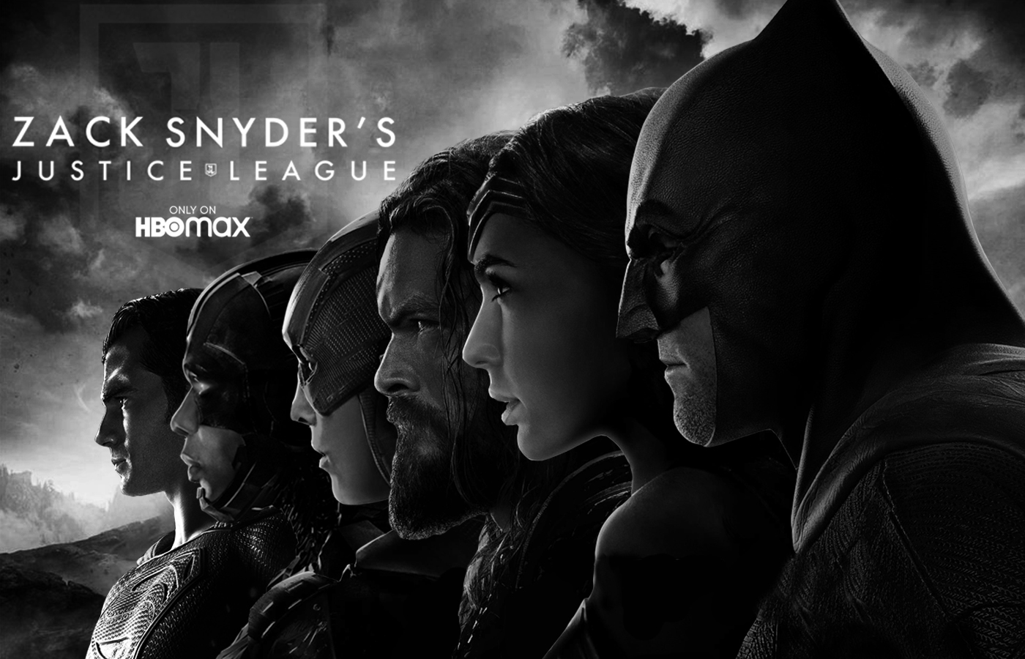
Submitted to : Ms.Pooja Nautiyal

Slide 2
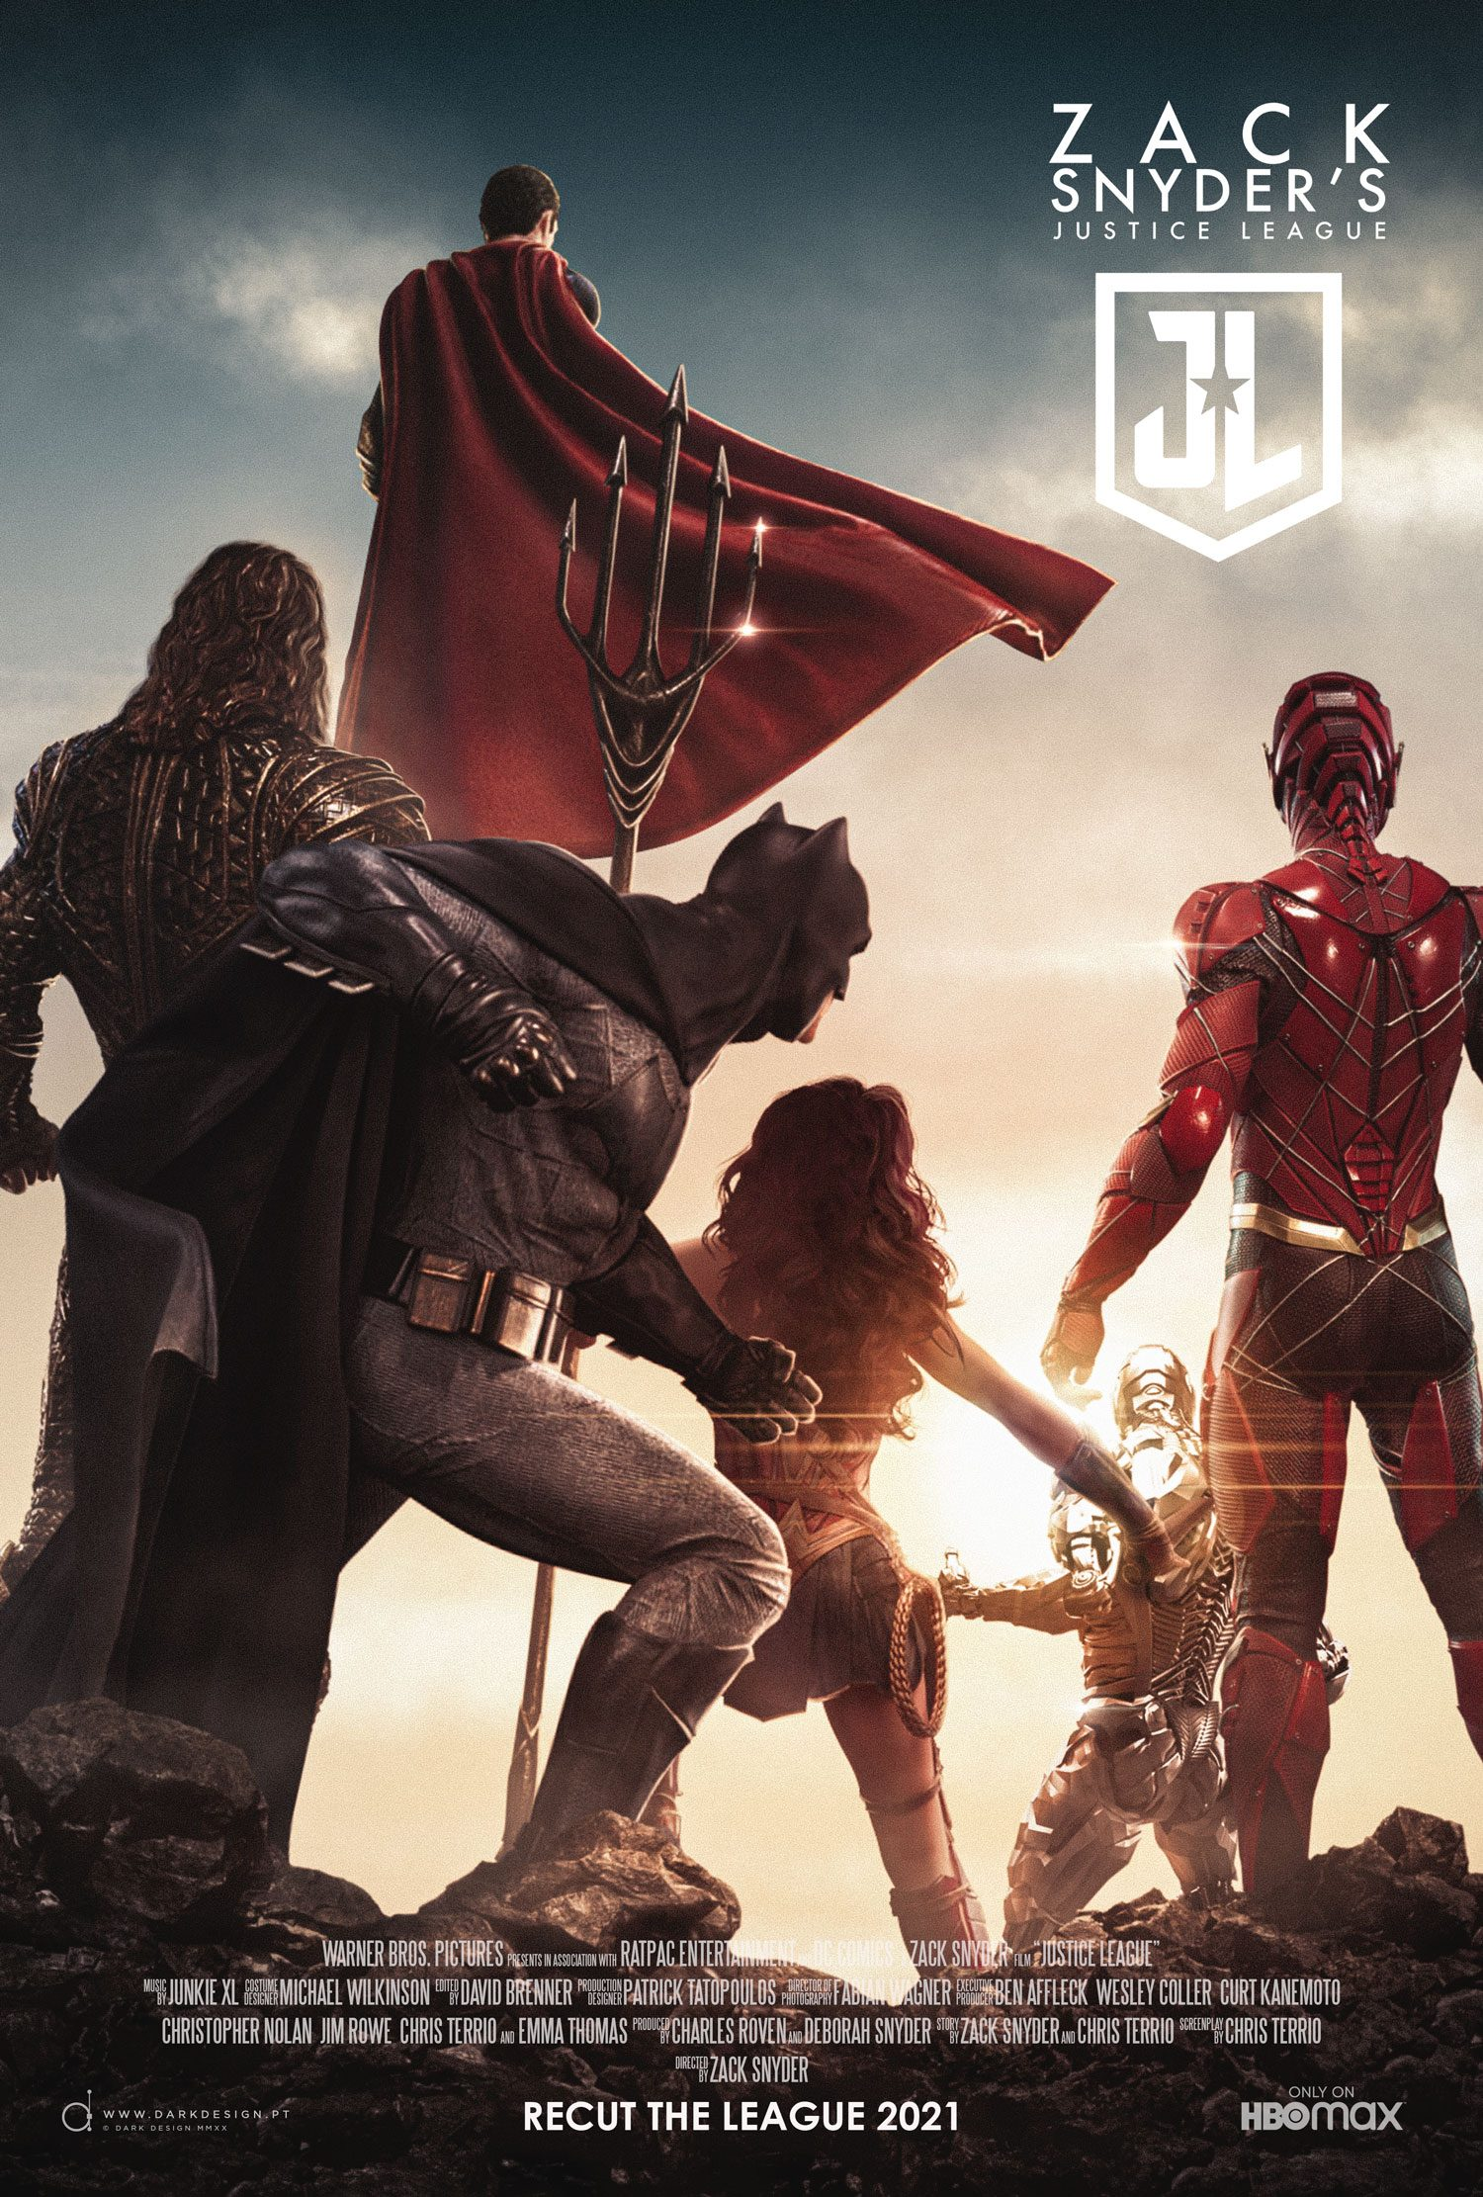
movie info
Rating: R (Violence|Some Language)
Genre: Action, Adventure, Fantasy
Original Language: English
Director: Zack Snyder
Producer: Deborah Snyder, Charles Roven
Writer: Chris Terrio
Release Date (Streaming): Mar 18, 2021
Runtime: 4h 2m
Production Co: Warner Bros. Pictures, HBO Max
Sound Mix: Dolby Atmos, Dolby Digital
Aspect Ratio: Academy (1.33:1)
collection: DC Extended Universe

Slide 3
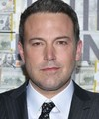





cast & crew
Ben Affleck
Batman, Bruce Wayne
Gal Gadot
Wonder Woman, Diana Prince
Henry Cavill
Superman, Clark Kent
Jason Momoa
Aquaman, Arthur Curry
Ezra Miller
The Flash, Barry Allen
Ray Fisher
Cyborg, Victor Stone

Slide 4
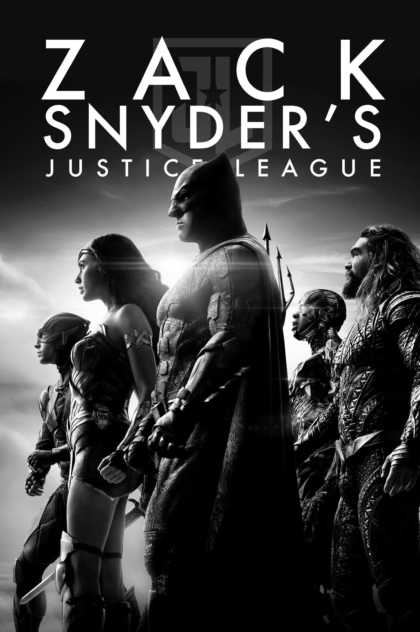
synopsis
In ZACK SNYDER'S JUSTICE LEAGUE, determined to ensure Superman's (Henry Cavill) ultimate sacrifice was not in vain, Bruce Wayne (Ben Affleck) aligns forces with Diana Prince (Gal Gadot) with plans to recruit a team of metahumans to protect the world from an approaching threat of catastrophic proportions. The task proves more difficult than Bruce imagined, as each of the recruits must face the demons of their own pasts to transcend that which has held them back, allowing them to come together, finally forming an unprecedented league of heroes. Now united, Batman (Affleck), Wonder Woman (Gadot), Aquaman (Jason Momoa), Cyborg (Ray Fisher) and The Flash (Ezra Miller) may be too late to save the planet from Steppenwolf, DeSaad and Darkseid and their dreadful intentions.

Slide 5
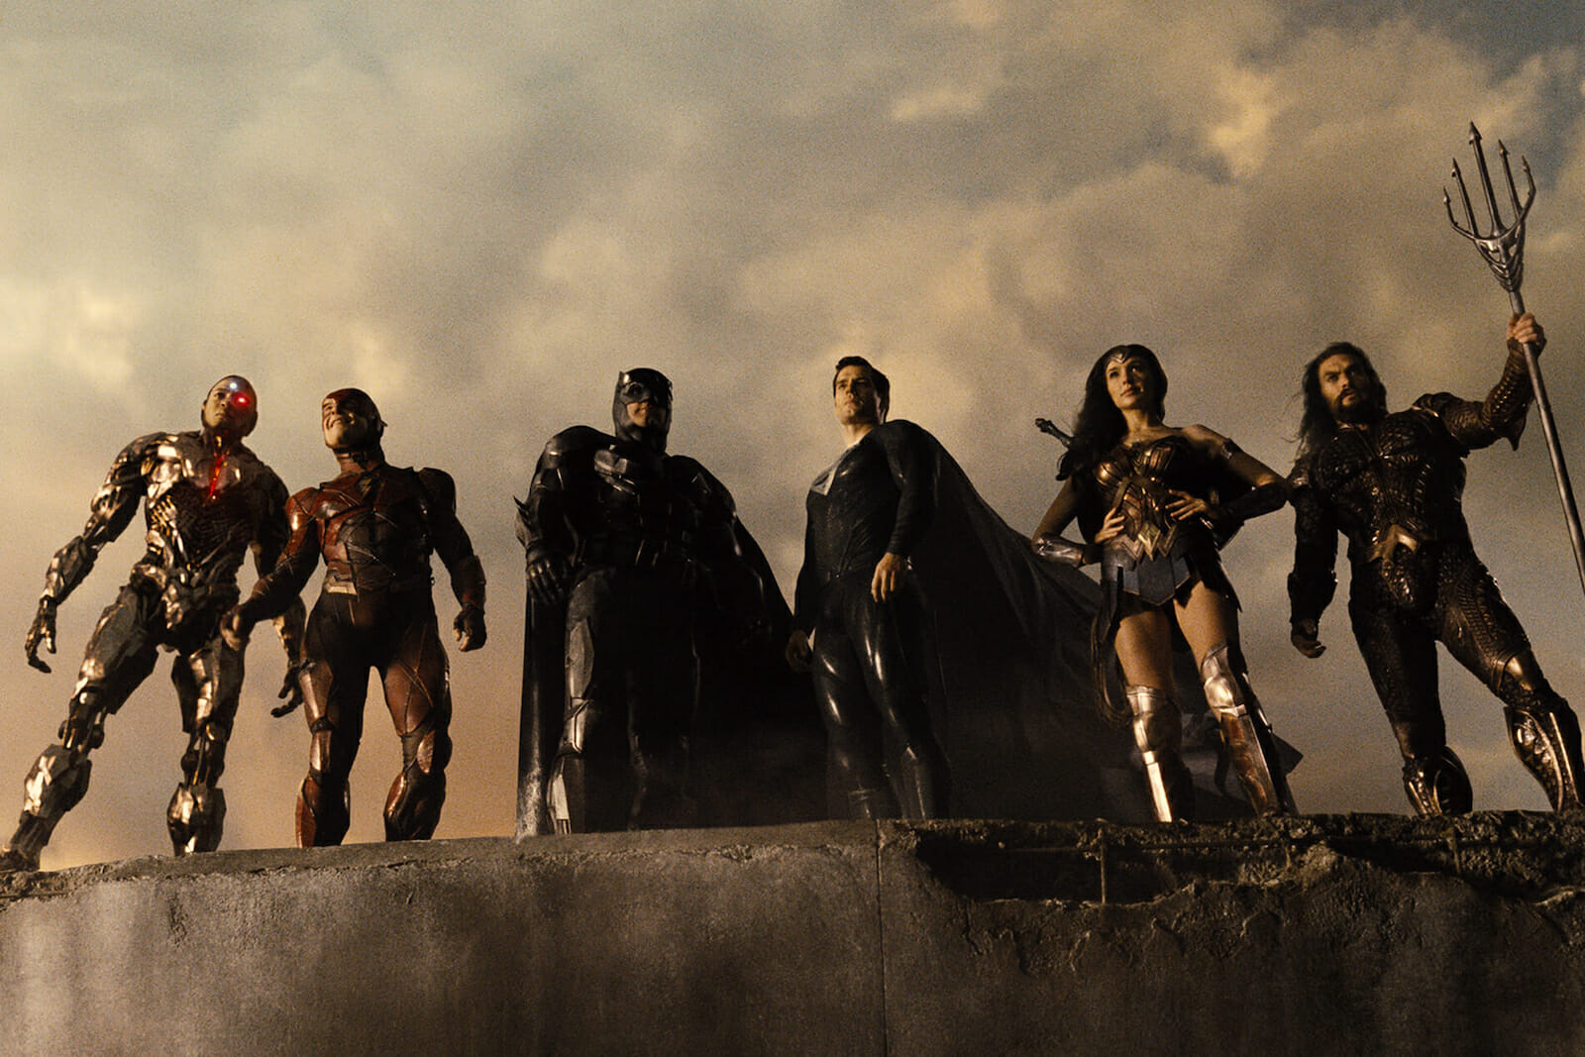
Deepankar Sharma
‘’Zack Snyder’s Justice League‘’
review
In the wake of the original Justice League’s failure,
Jack Snyder’s fans and defenders have argued that had he been allowed to complete his original film, it would have turned out differently.This became the #ReleaseTheSnyderCut movement, which lobbied Warner Bros. to release Snyder’s original cut.

Slide 6
The movie is broken down into 6 parts and an epilogue. It more or less follows the plot of the theatrical cut, but with some deviations and a lot expanded upon. Much of the action revolves around antagonist Steppenwolf (Ciarán Hinds) coming to Earth to find Mother Boxes, powerful objects that could grant him world domination. As the world grieves Superman’s sacrificial death as depicted at the end of Batman v. Superman, Bruce Wayne (Ben Affleck) seeks out new superheroes to help save the world. As Wonder Woman, Aquaman, Cyborg, and the Flash all eventually join him, Steppenwolf devastates Wonder Woman’s home of Themyscira and Aquaman’s ancestral home of Atlantis, gathering more Mother Boxes and power. The team decides that their best hope against Steppenwolf is to resurrect Superman through the power of the one Mother Box they have in their possession. When Superman does return, he’s not immediately the hero he used to be, as he tries to fight his former friends and allies. Eventually, it’s up to the newly assembled Justice League to go all-in for a final, climactic battle at an abandoned nuclear site in Russia, where Steppenwolf hopes to perform the final ritual to take over the world.

Slide 7
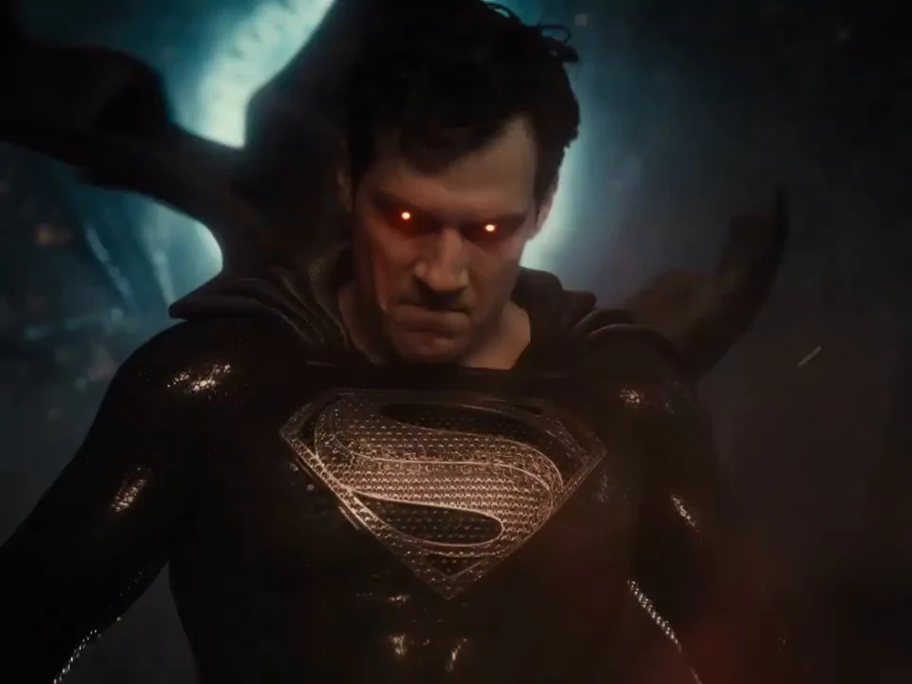
And yet, the movie is 4 hours long, and that doesn’t even begin to summarize all the side-plots, character development, and other machinations going on within the narrative. But that time allows space and room for scenes to breathe, to develop tension, and to build up the prospect of these heroes coming together to stop the bad guy. There is an easiness to Zack Snyder’s Justice League that the theatrical cut simply didn’t have. It’s easy to slip into, and while things can sometimes take you out of the experience, it’s not nearly as boring or as much of a slog as its theatrically released counterpart. It’s also funnier than the theatrical cut, and the dialogue and character interactions generally feel more natural.

Slide 8
Character motivations are much clearer this time around, as informed by expanded backstories. The character who gets fleshed out the most in this new edition is Ray Fisher’s Cyborg. Fisher, who has been outspoken in his disdain for Whedon and how drastically the production was interfered with, really shines as his character is given much more backstory, development, and depth. Also of note is Ezra Miller’s Flash, who still is the comedic relief of the film in a lot of ways but doesn’t have as many corny jokes and definitely doesn’t seem to be as pathetic a figure as his theatrical cut counterpart. The Flash even ends up saving the day at the film’s climax by reversing time in what I believe is supposed to be a nice homage to 1978’s Superman. This is a marked difference for a character that Batman had to demand to save just one person in the theatrical cut. Wonder Woman and Aquaman feel more like themselves here, more like the characters that would make their respective spin-offs so successful. Also expanded is the role of the overarching uber-bad, Darkseid (Ray Porter). He is alluded to in the theatrical cut, but in Zack Snyder’s Justice League, he is featured outright, a menacing master for whom Steppenwolf is operating. Darkseid is an imposing figure in the DC universe, one of its most famous antagonists, as well as one that influenced the development of Thanos for rival Marvel Comics. His cinematic debut is a more than fitting one.

Slide 9
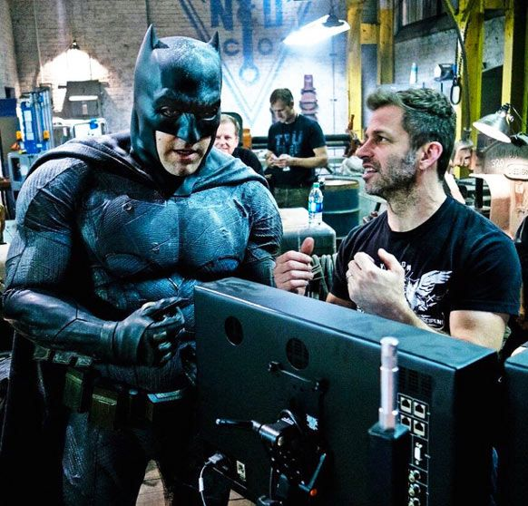
This movie is crafted well, and while Snyder’s love of a darker color pallet is prominent.Additionally, there’s another “Knightmare” scene that showcases a dystopian future where Superman has gone bad, the former members of the League are trying either to kill him or send a message about Lois Lane (Amy Adams) into the past in order to prevent…something? A similar “Knightmare” scene in Batman v. Superman was one of the more baffling things about that movie, which is saying a lot. It is similarly awkward here, particularly because of a cameo appearance by Jared Leto’s widely-dismissed take on the Joker, who had only previously appeared in 2016’s Suicide Squad.

Slide 10
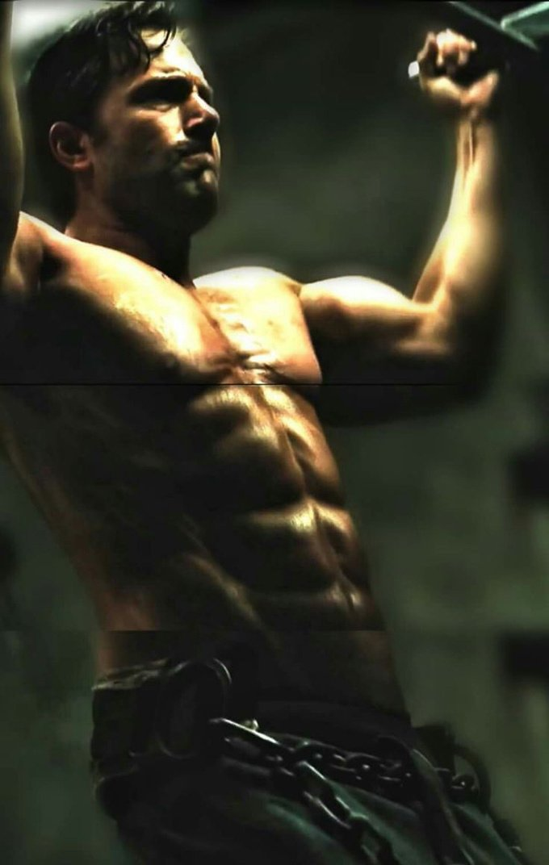
Fans also wondered about how the differences in presentation affected my judgment. They saw Justice League theatrically in an admittedly mostly empty theater, whereas Zack Snyder’s Justice League was enjoyed in the company of socially distanced friends on a friend’s flat-screen television.
Overall, they must admit how surprised they were with just how much they enjoyed Zack Snyder’s Justice League. It’s big, it’s epic, and it feels like an appropriate culmination and crescendo for this superhero universe. It’s clear that Snyder’s original vision for the film was compromised, and why the studio saw fit to remove as much as it did. So many of the things they ended up removing don’t just work, but work well, which is truly baffling. This new edition does a fitting justice to its iconic characters in a way the theatrical cut never did and it feels like a vindication for Snyder.

Slide 11
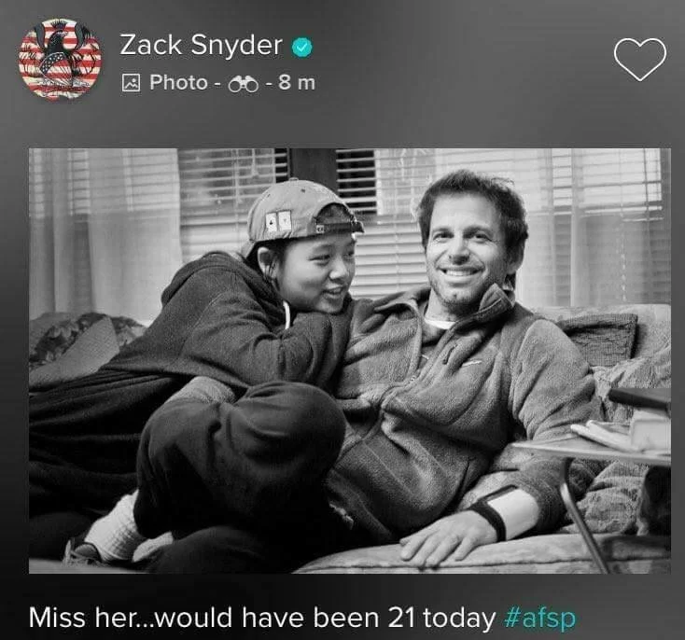
But at the end of the day, they were glad that a studio chose to do right by someone who had suffered an immeasurable tragedy, and whom they had seemingly screwed over in the midst of that staggering grief. For a multitude of reasons, this project was very personal. Easily the most touching thing to come from the movie is a simple title card that comes up at the film’s conclusion, right before the credits, dedicating it to Snyder’s late daughter, Autumn, who had committed suicide.

Slide 12
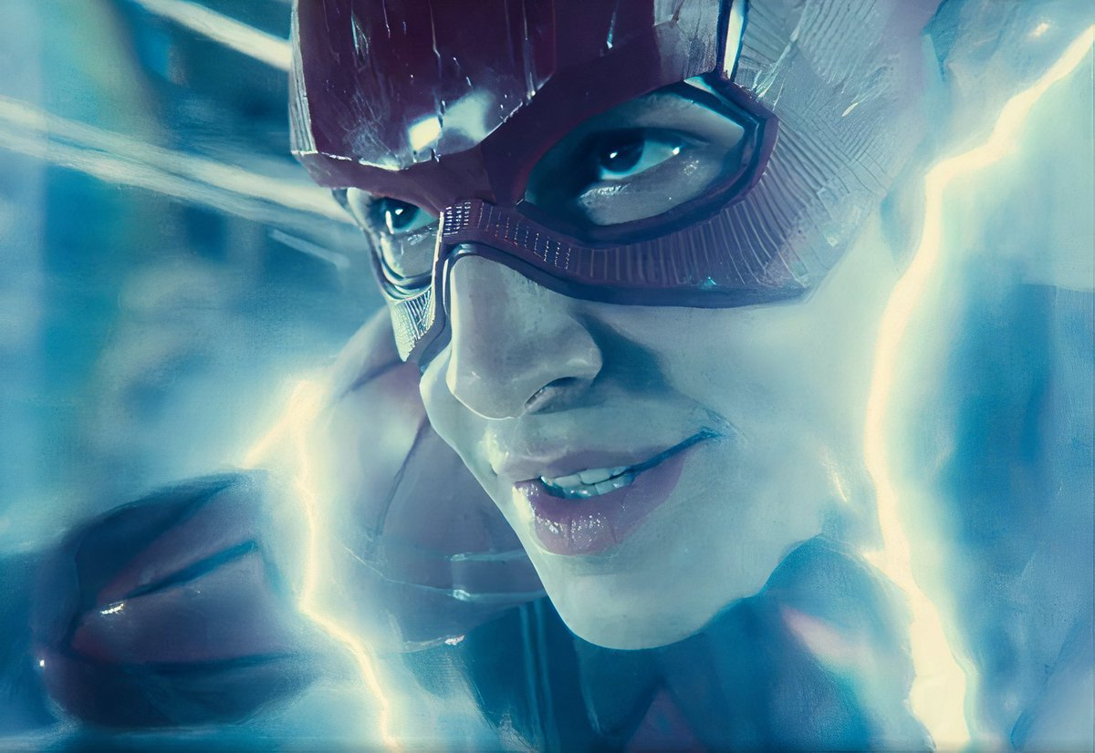
conclusion
why should you watch?
A rip-roaring superhero action picture in its own right, and more than justifies all the considerable resources and effort poured into it.
Regardless of whether you enjoy Snyder's darker, more morbid take on DC superheroes, there's no denying his 4-hour (!) cut of "Justice League" is a solid, all-engrossing picture

Slide 13
